Slide 1
IMPACT OF NATIONWIDE COVID 19 PANDEMIC LOCKDOWN ON HABITAT OF ENDANGERED DOLPHINS PLATANISTTICA, GANGETICA : ISSUES & CHALLENGES IN CONTEXT OF ITS REHABILITATION IN RIVER GANGA
VR CHITRANSHI
EX ADG FISHERIES
ICAR, NEW DELHI

Slide 2
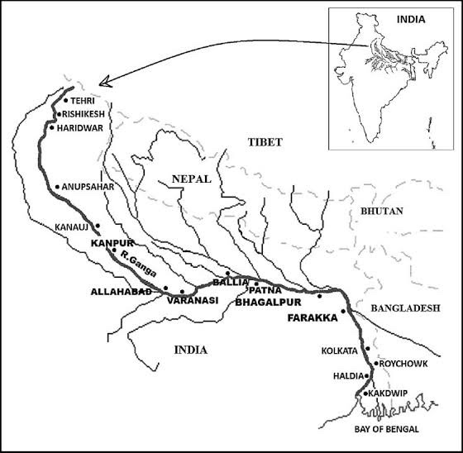
SIGNIFICANCE OF GANGA ECOSYSTEM
National River of India
Mega hot spot of aquatic biodiversity in world
Gene bank of endangered Dolphin & carps
Catfishes mahseer prawn. Bagarius Otter.
River Shark (Glyphis) Sting ray (Himmantura)
Main inland capture fisheries Resource of India
Contribute in food basket & nutritional security
Fig 1. Map Of Ganga River System

Slide 3
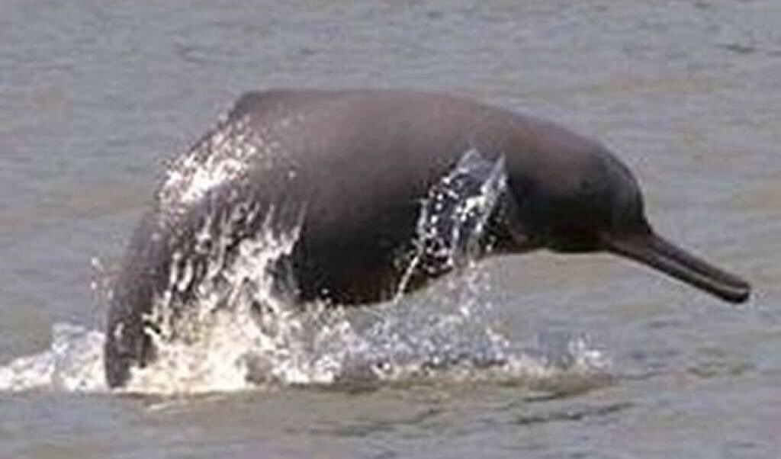
SIGNIFICANCE OF GANGETIC DOLPHIN
National Animal of India
Aquatic lion of Ganga river
Bio indicator of health of river
Apex position in river food chain
IUCN Red book list as endangered
Protected : wildlife protection act 1972
Fig 2. Gangetic Dolphin

Slide 4
PRESENT STATUS OF DOLPHIN POPULATION IN GANGA RIVER
Natural home - Ganga & It's Tributaries
Gandak, Ghaghra, Chambal, Son, Kosi
Perennial deep slow current water
PAST. thick population in Gangetic plain
PRESENT below 1200 in isolated pockets
Narora ,Varanasi, (DhakaWANs), Buxar, Patna, Bhagalpur
Fig 3 . Map Showing Dolphin Distributional Zone Of River Ganga

Slide 5
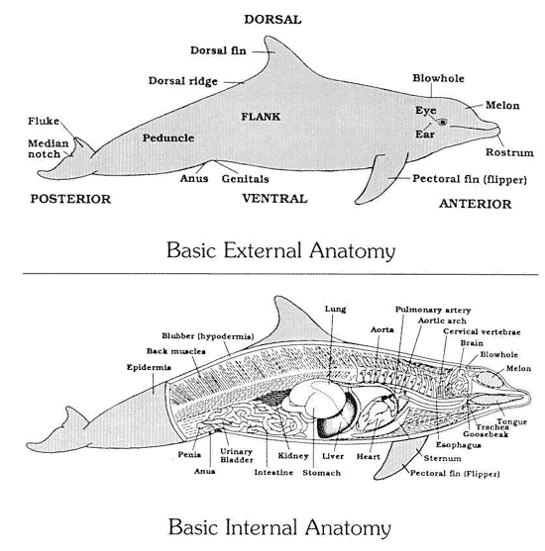
TAXONOMY AND MORPHOLOGY OF GANGETIC DOLPHIN
CLASS MAMMALIA ORDER CETACEA FAMILY PLANTANISTIDAE
Long beak with teeth, tinny eye blowhole
Bulky body flexible neck,long flippers tail fluke
Grey brown colour 2 m long with 80 kg wt
Solo side swimmer jump out of water.air breather
Navigation hunting by ultrasonic echolocation
Blind Communication by whistles clicks late maturity
Polygamy parental care give live birth to calves

Slide 6
ECOLOGICAL STATUS OF RIVER GANGA: BEFORE 24TH MARCH 2020
Integrity broken perennial beauty lost
High turbidity visibility clarity lost
Level of DO, pH low but BoD CoD high
River water highly polluted and contaminated
River depth shallow current velocity slowflow
Deformed river bed with high organic debris
Mineralisation capacity, food chain disrupted
Biotic life under stressful conditions

Slide 7
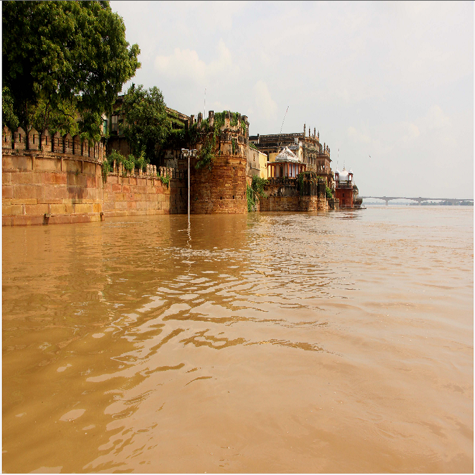
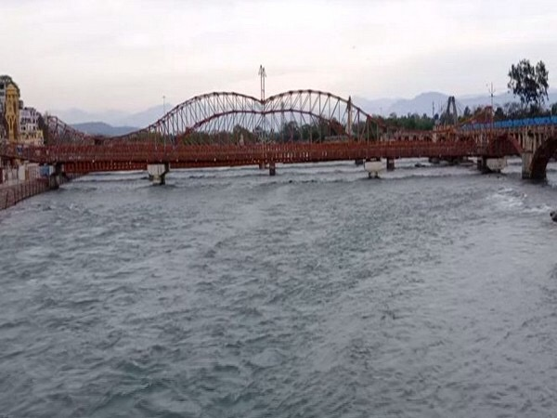
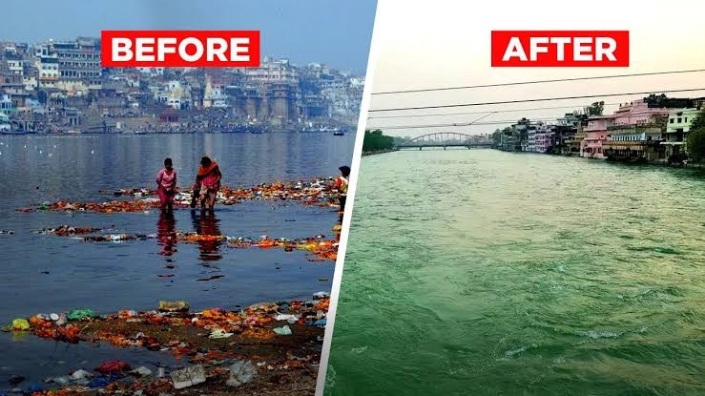
ECOLOGICAL STATUS OF RIVER GANGA AFTER LOCKDOWN
Table – COMPLETE CONTROL ON SOURCE OF POLLUTING UNITS
No of Polluting industries | 764
Pollution load ton/day | 131
Sewage load million litres/day | 12,000
Treatment capacity million litres/day | 4000
Impact: increase in transparency, clarity, visibility
Desired level of DO , pH, BOD and COD

Slide 8
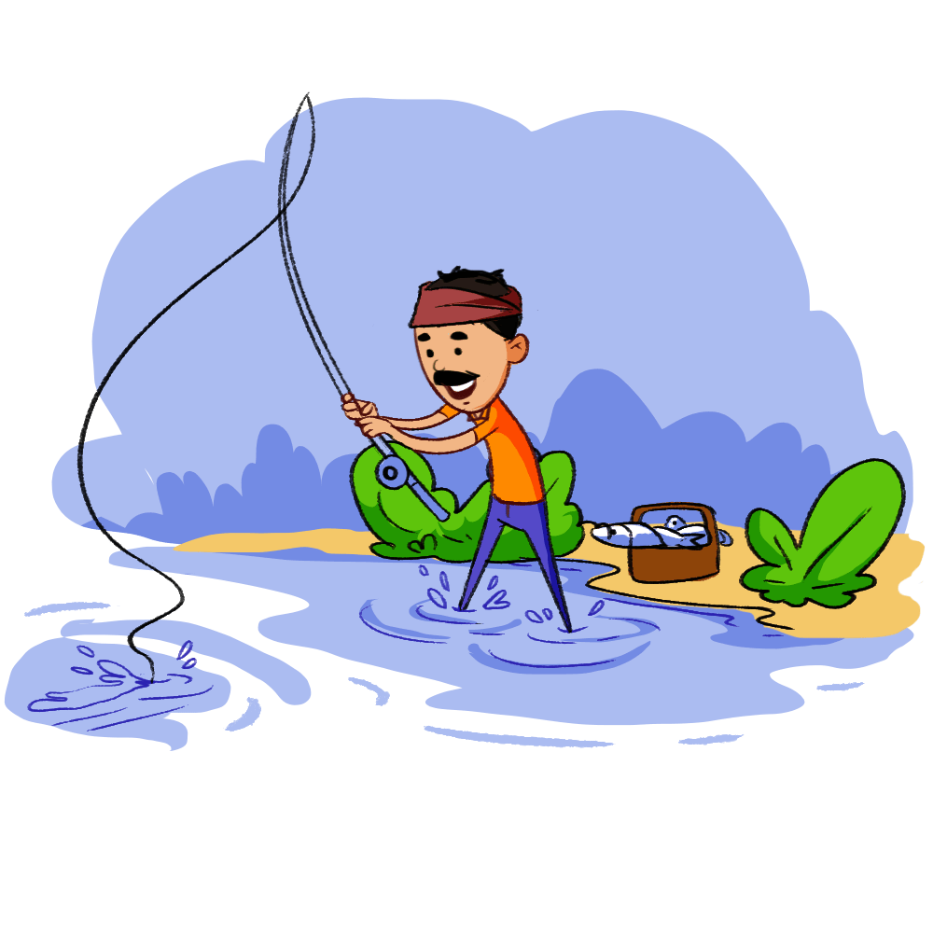
IMPACT ON POPULATION AND PRODUCTION DYNAMICS
Table – CONTROL ON DEMOGRAPHIC AND FISHING PRSSURES
Ganga Basin | 448.3 million
Ganga Plain | 496 million
Fisherman | 10-13 million
IMPACT: fishing closed during spawning period
Collection of spawners and seed stopped
Natural auto stalking of fishes in river
Improvement in population and production of fishes

Slide 9
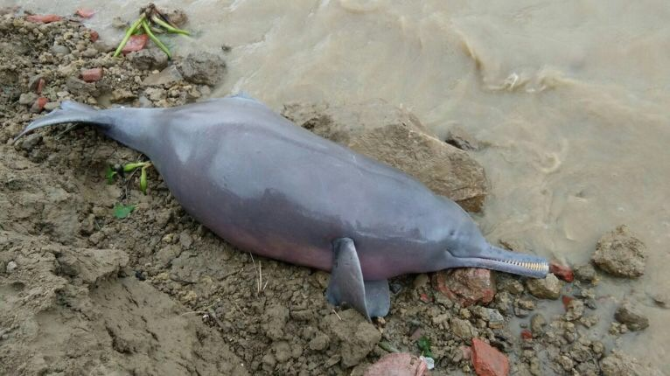
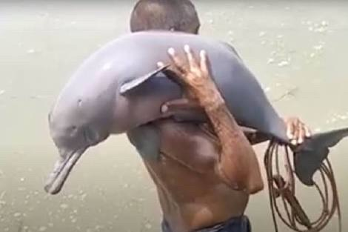
IMPACT ON REVIVAL OF DOLPHIN POPULATION IN GANGA (AFTER APRIL)
Stretch | Place | State | Date of visibility
Upper ganga | Katarni Ghat, Meerut | UP | 15 April 2020
Middle ganga | VGDS, Bhagalpur | Bihar | 25 April 2020
Lower ganga | Babu Ghat, Kolkata | West Bengal | 25 April 2020
Burhi Gandhak | Tepari, Muzaffarpur | Bihar | 27 July 2020
Gandak | Purnia | Bihar | 7July 2020
Gandak | Begusarai | Bihar | 20 July 2020

Slide 10
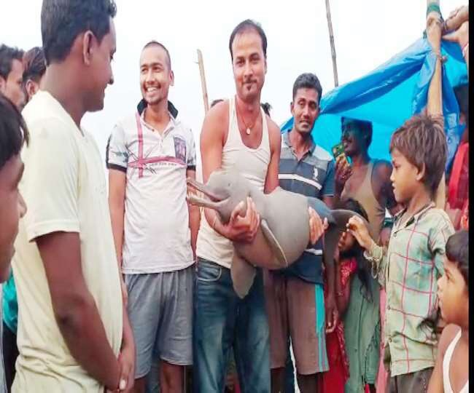
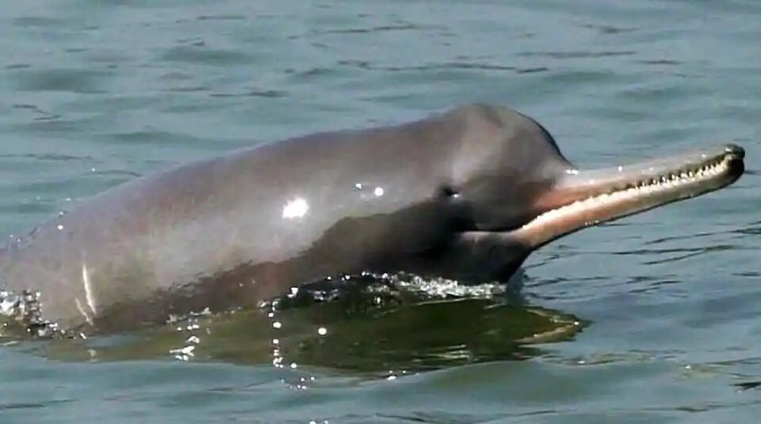
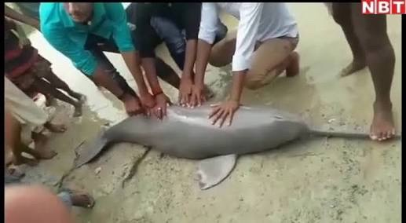
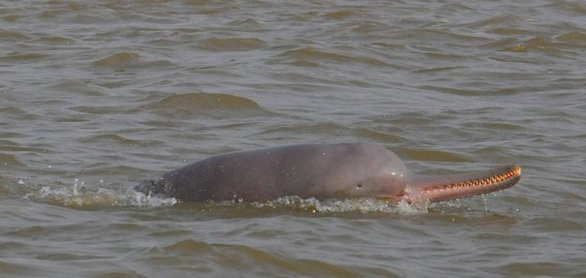

Slide 11
ISSUES AND CHALLENGES
Management Of Dolphin is tedious task
Vulnerable species in vulnerable river
Control on hunting killing & Poaching
Restoration of health condition of habitat
Late maturity long gestation period milk feeding
Anticipated impact :dredging & noise pollution

Slide 12
REHABILITATION PERSPECTIVES
Creation of dolphin parks in tributaries
Creation of Dolphin Research Centre at CIFRI
Creation of multi institutional dolphin advisory group
Skill development in dolphin management programmes
Creation of Ganga scout cadre
Legal monitoring by wildlife crime control Bureau

Slide 13
THANK YOU

